Slide 1
Reading Hertzsprung-Russell Diagrams

Slide 2
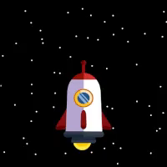
By the end of this lesson, you should be able to:
Determine absolute magnitude by comparison to a Hertzsprung-Russell diagram.

Slide 3
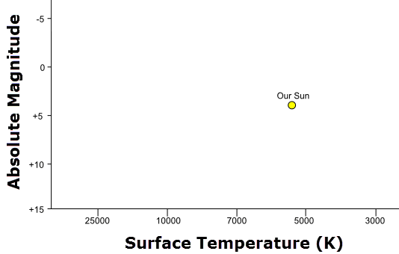
So if we can find the absolute magnitude when we know the distance to the star, how do we find it when we don't?
Ejnar Hertzsprung and Henry Norris Russell independently solved this problem in 1911 and 1913 respectively. They plotted the temperature of stars against their absolute magnitude.
For example, here is the Sun plotted on such a graph.

Slide 4
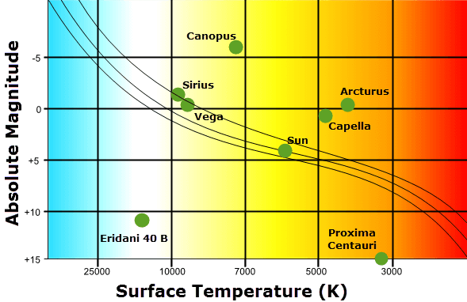
An interesting pattern emerged - about 90% of stars have an absolute magnitude related to their temperature.
The diagram is now called a Hertzsprung-Russell diagram. It charts temperature on the x-axis and absolute magnitude on the y-axis.

Slide 5
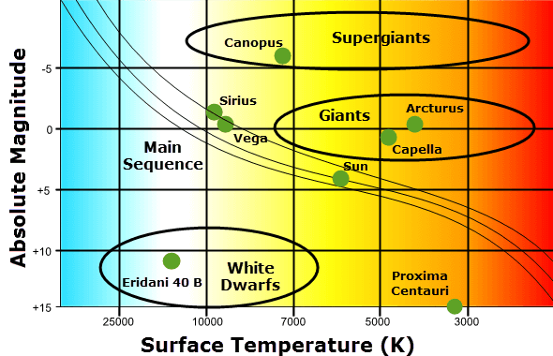
The central band of the Hertzsprung-Russell (H-R) diagram is known as the main sequence.
This is a broad line travelling from the top left to the bottom right of the diagram.
90% of stars are part of the main sequence. Dwarf stars and giant stars are not part of the main sequence, and form clusters off to the sides.

Slide 6
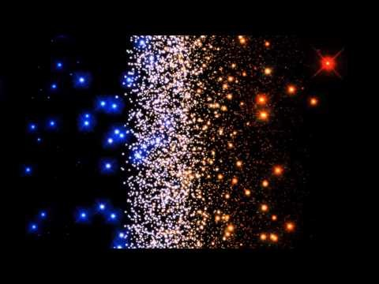

Slide 7
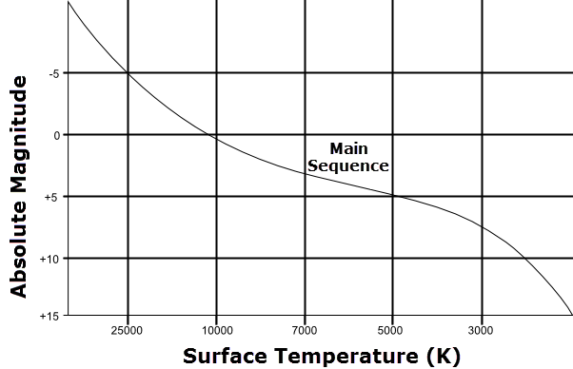
If we know the temperature of a star, we can assume it is part of the main sequence and use that line to calculate the absolute magnitude.
Example:
A star has a temperature of 7000 K. Identify the absolute magnitude of that star.

Slide 8
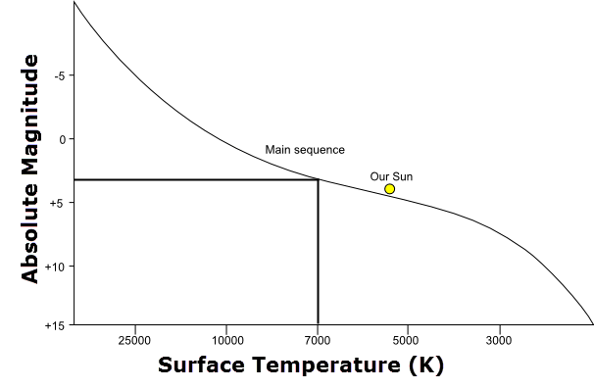
Solution:
Temperature of star = 7000 K
Follow a line up from the Surface Temperature axis to where it intersects with the main sequence line.
Then follow another line across to the Absolute Magnitude axis.
Finally, read off or estimate the absolute magnitude.
For this star, the absolute magnitude is approximately 3.

Slide 9
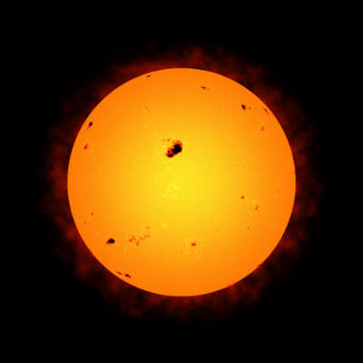
H-R Diagrams and Units
Remember, magnitudes have no units; the absolute magnitude is just a number.
The difference between ∘C and K is only ±273. For solar temperatures we can ignore this difference when estimating the absolute magnitude.
This means we don't need to worry what units a solar temperature is given in. The difference between 7000∘C and 7273 K is insignificant.

Slide 10
Let us track the life of a couple of stars, and see where they move on the Hertzsprung-Russell Diagram during the course of their lifetimes.
A star first appears on the Hertzsprung-Russell diagram when it begins to fuse and give off light.

Slide 11
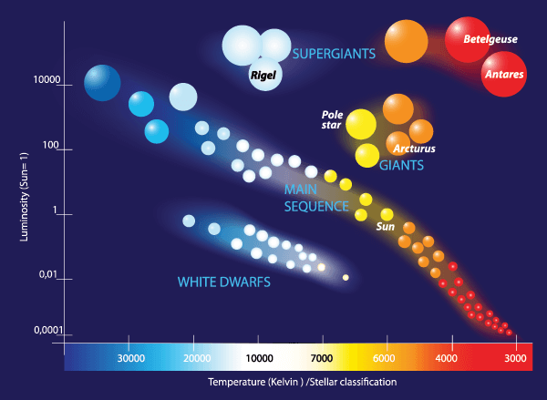
The Sun began as a main-sequence star, as you can see in the diagram below.
Currently it is about half-way through its time as a main sequence star.
It is a class-G star, with a yellow colour, at a temperature of about 5,700∘K.

Slide 12
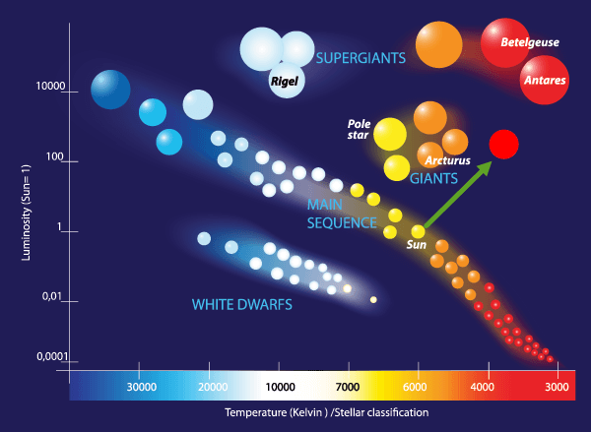
The Sun will become a red giant once its core hydrogen is used up.
As a red giant it will have left the main sequence, instead existing to the right of the "Giants" section below.
The red giant Sun will be 100 times as luminous as the current Sun. It will also be a few hundred degrees colder, on average.
The red giant phase will move the sun into the M class, as its temperature falls and colour becomes red.

Slide 13
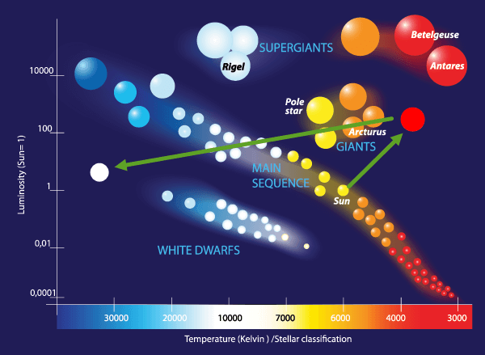
Once the Sun's core helium is used up, it will eject its outer layers as a planetary nebula. The Sun is now a white dwarf.
Initially, a white dwarf has a massive temperature and low luminosity, securing its place on the bottom left of the diagram.
The Sun will join the spectral classes B or A with its colour being white or blue-white.

Slide 14
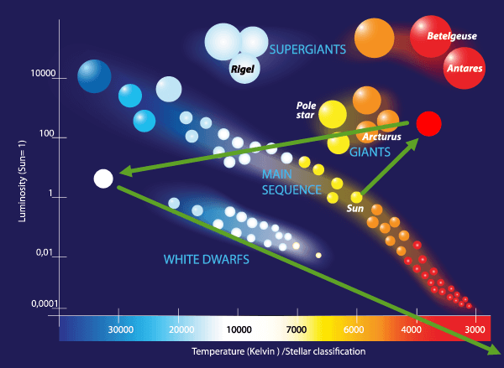
Over its life the star will cool and lose brightness, dropping towards the bottom right over billions of years.
It goes from spectral class B to spectral class M.
It reaches class M as a black dwarf, a ball of matter releasing very little to no light.

Slide 15

Rigel is a blue supergiant, the seventh-brightest star in the sky.
It began as a smaller and hotter star on the main sequence, with a blue-white colour, in class B.

Slide 16
As it aged, Rigel grew to a gigantic size.
It became a blue supergiant, reaching an incredibly high brightness and lowering in surface temperature.
The spectral class continues to be B, with a blue-white colouring.

Slide 17
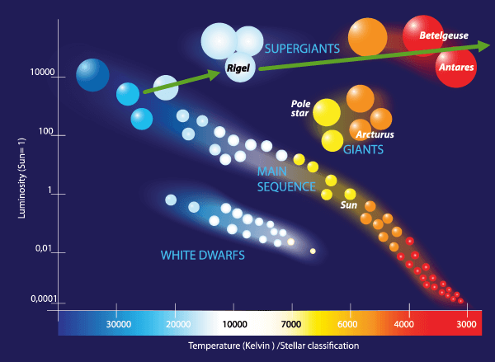
The lifespan of the supergiant Rigel will cause it to gradually cool without changing brightness much.
It eventually becomes a red supergiant, reaching spectral class M with a much lower temperature.
After the red supergiant stage, the star undergoes a supernova and leaves the Hertzsprung-Russell diagram. Neutron stars and black holes, which a post-supernova star will become, are not on the chart.

